Slide 1


CSYE6000 Object Oriented Design Daycare
Team
Maharshi Jinandra
Shreya Kichloo
Hamad Alsuhaibani

Slide 2
Contributions
Maharshi Jinandra : Back-end, table structure, data –structure design
Shreya Kichloo: Front end and UI design and integration, Report
Hamad : Data creation and Report

Slide 3
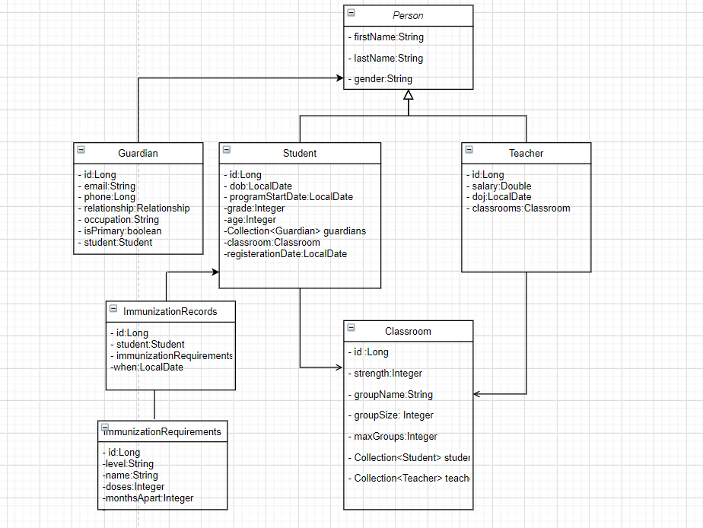
Design Solution

Slide 4
Design Solution
The approach that we followed was using a Spring boot framework which provided an Object Relational Mapping between the objects and attributes of the student, teacher, classroom classes in database.
Hibernate is the ORM framework that has been implemented in the Daycare design which provides not only the Factory Design pattern but also Domain model pattern, Query Design pattern and Data Mapper Pattern.
The database which has been used in the project is PostgreSQL
The model control view design is achieved by using Thymeleaf which is basically is HTML template engine. The bootstrap is used for providing design and styling of the UI screens
The alerts for the upcoming vaccinations, registrations and date of joining anniversaries for student’s and teachers are handled using simple mailing scheduling service via JavaMailSender Interface.

Slide 5
Design Features
Design Patter included in the project:
Factory Design pattern
Model Control View Design
Independently Learned
Spring boot framework
Hibernate Framework
Html, Bootstrap and CSS
Simple Mail Scheduler
PostgreSQL

Slide 6
Future Scope Implementation
Current solution implements and provides login capabilities for a system user, but the future implementation could include the following:
Providing Parental sign in and login access.
Giving role base access to teachers and other working staff.
Including a CRM module to keep track of business-related workflows.
Implementation of a ranking system for providing information regarding effectiveness among others similar facilities.

Slide 7
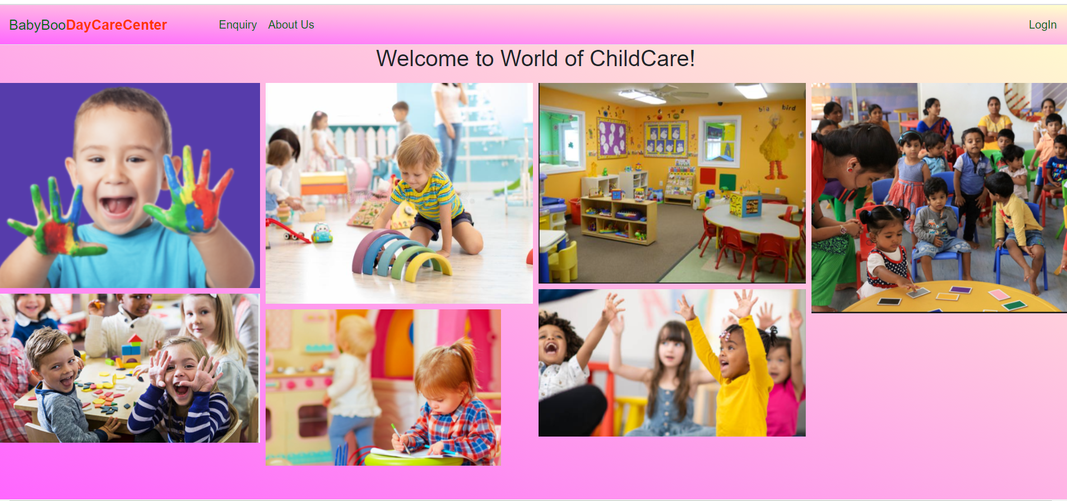
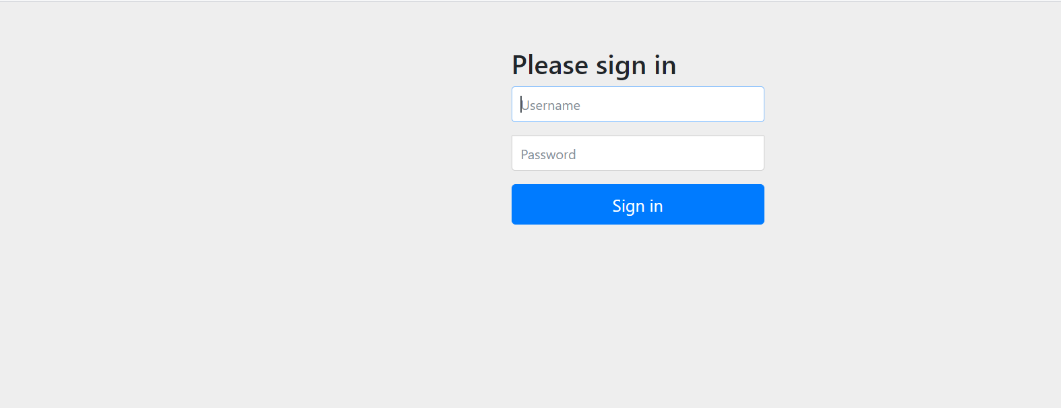
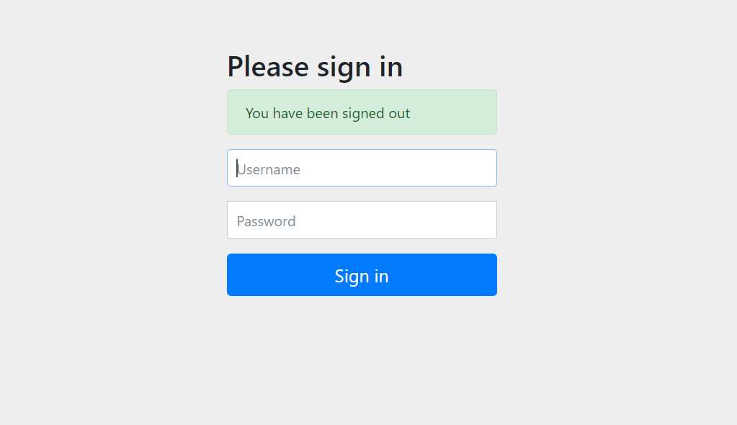
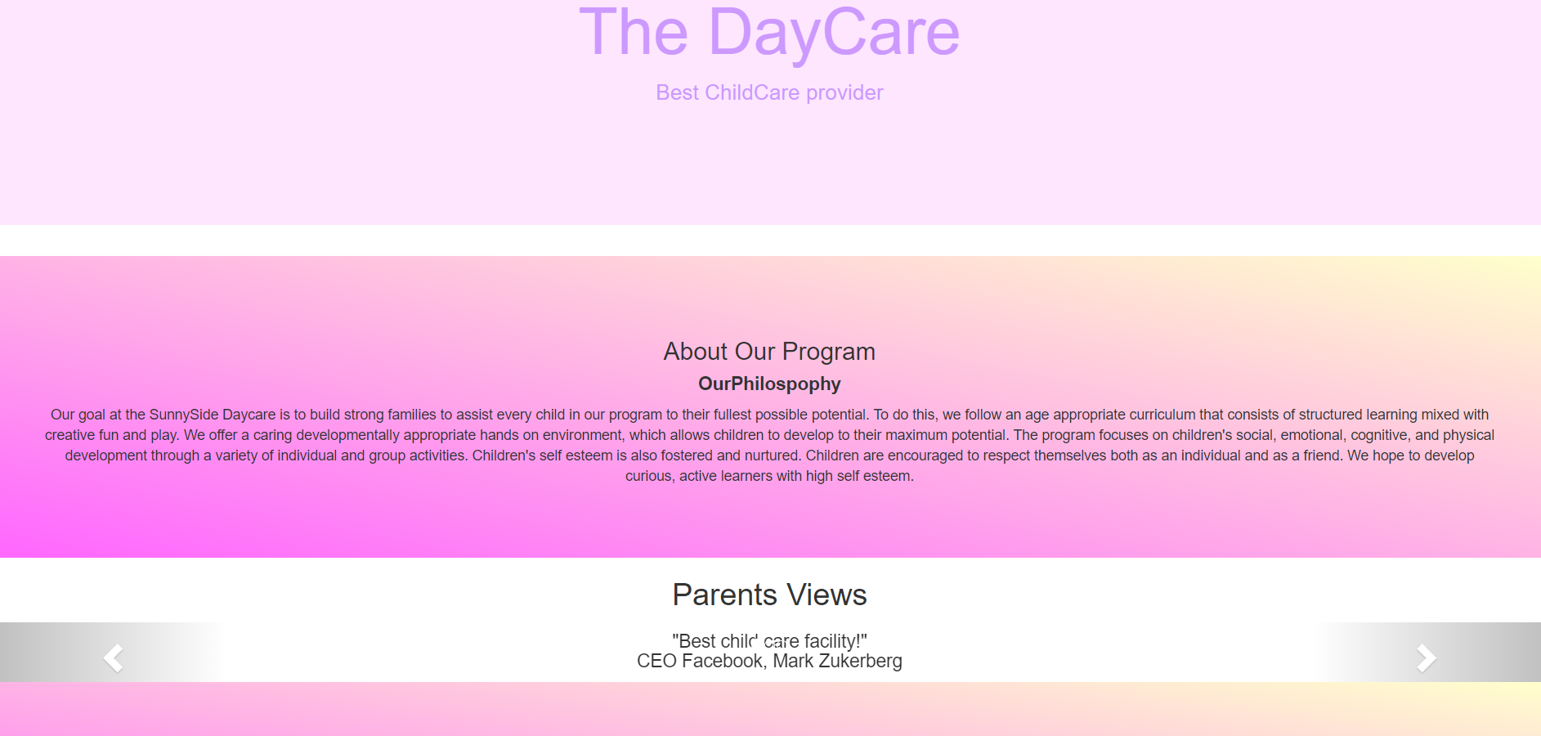
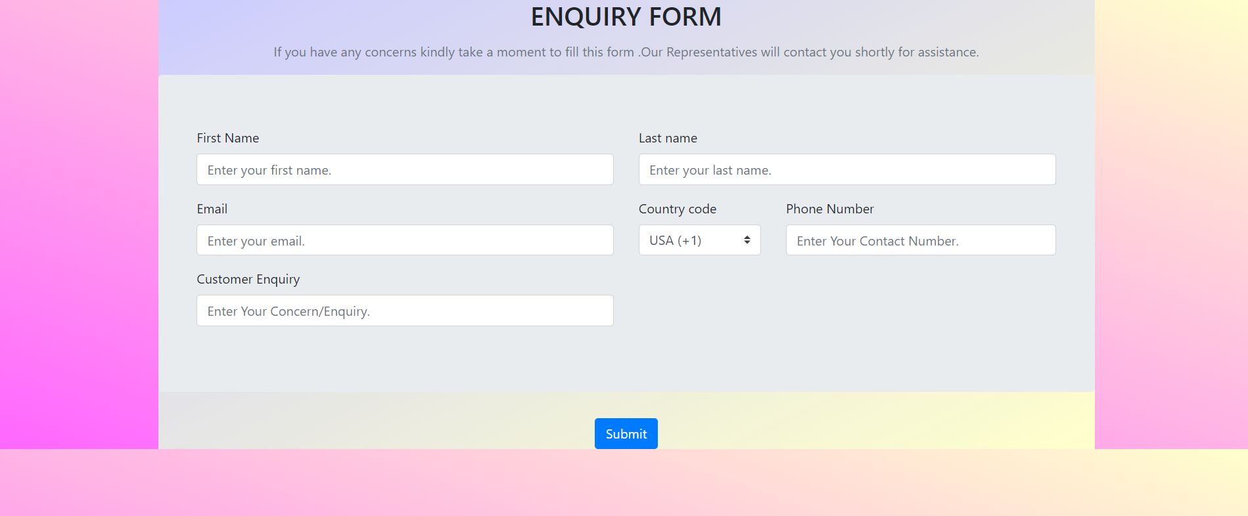
Snapshots

Slide 8
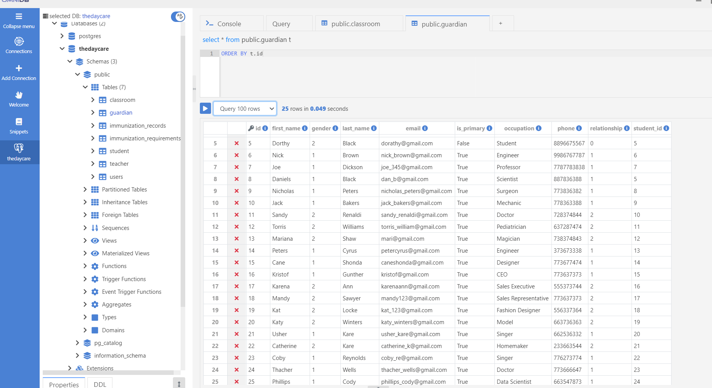
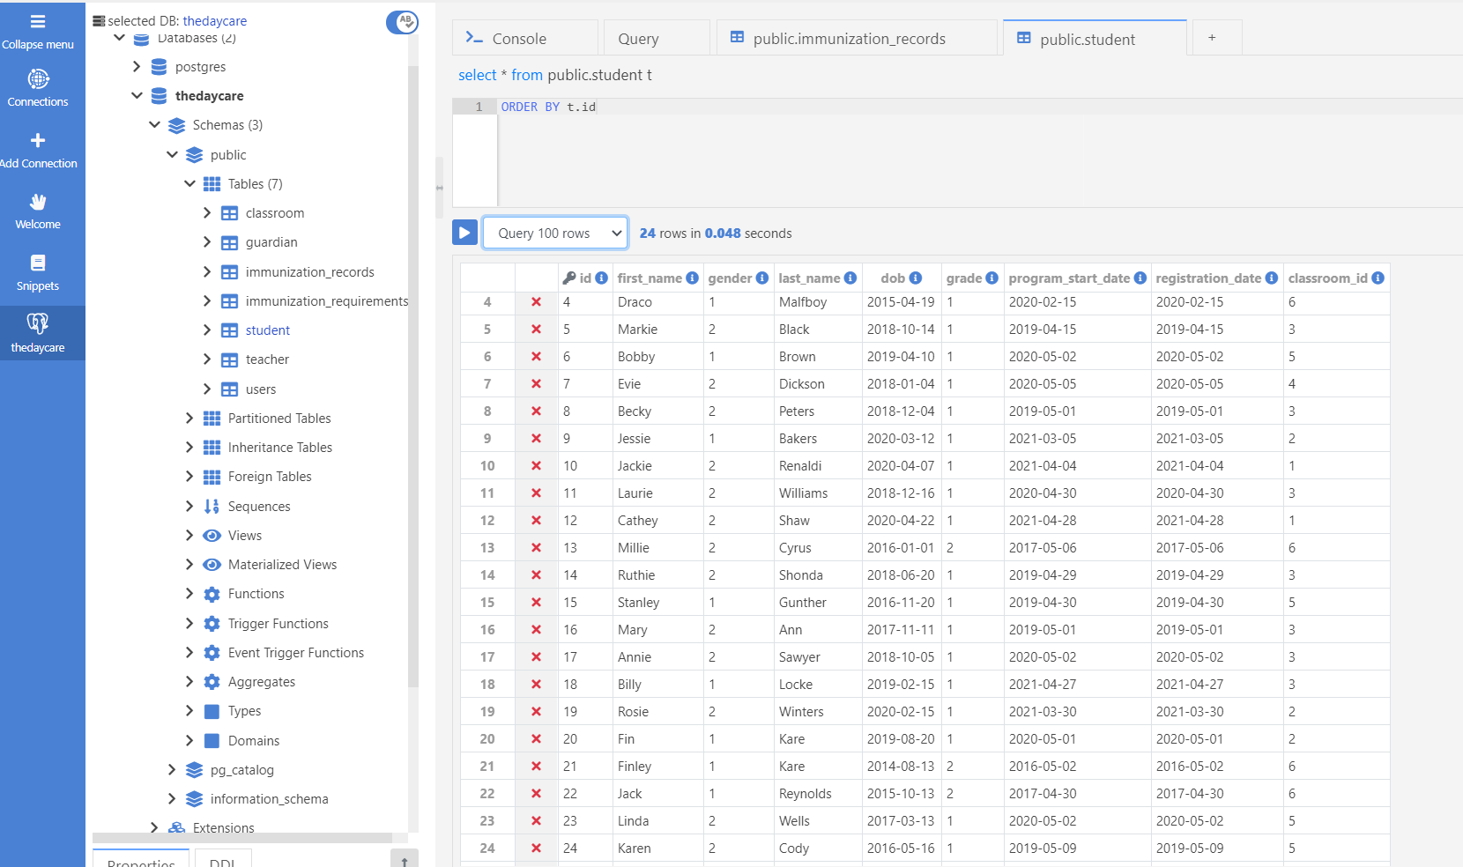
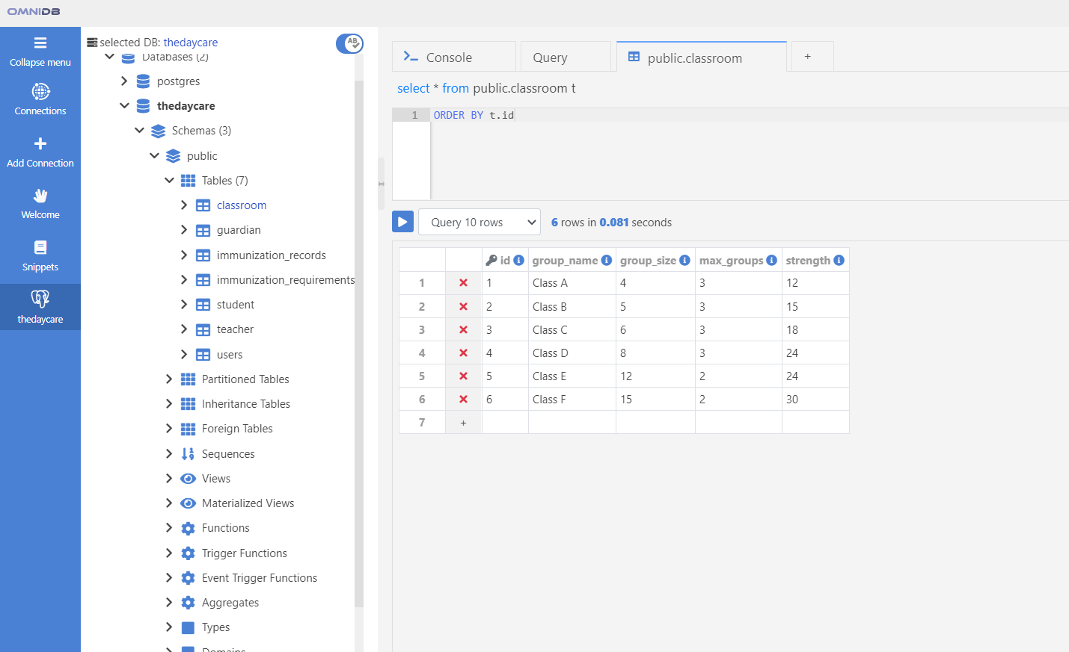
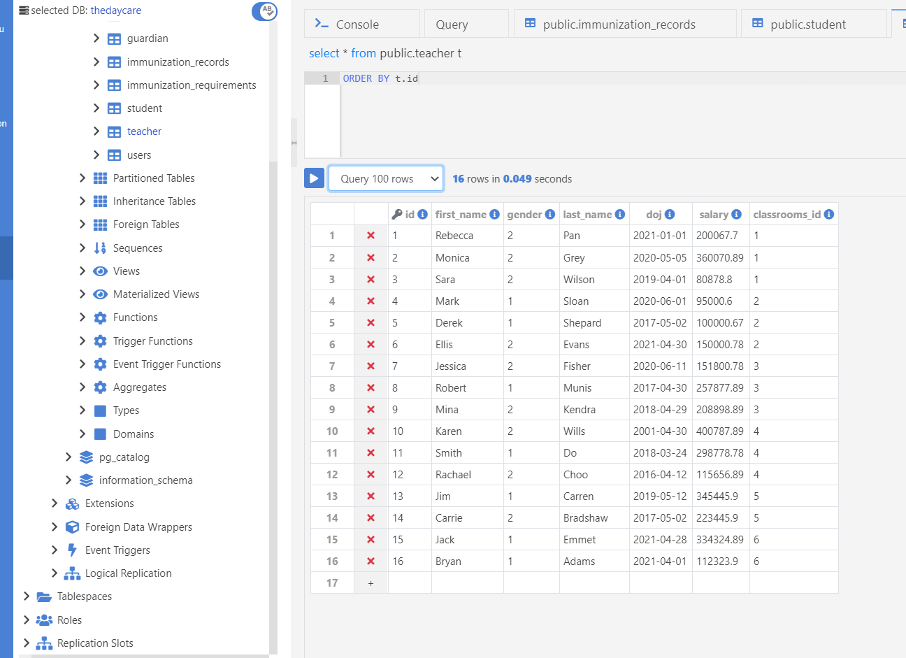

Slide 9
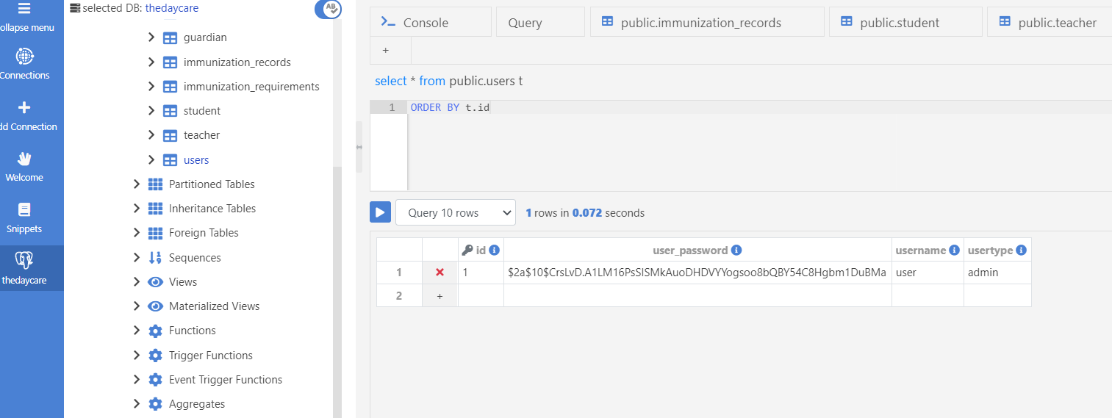
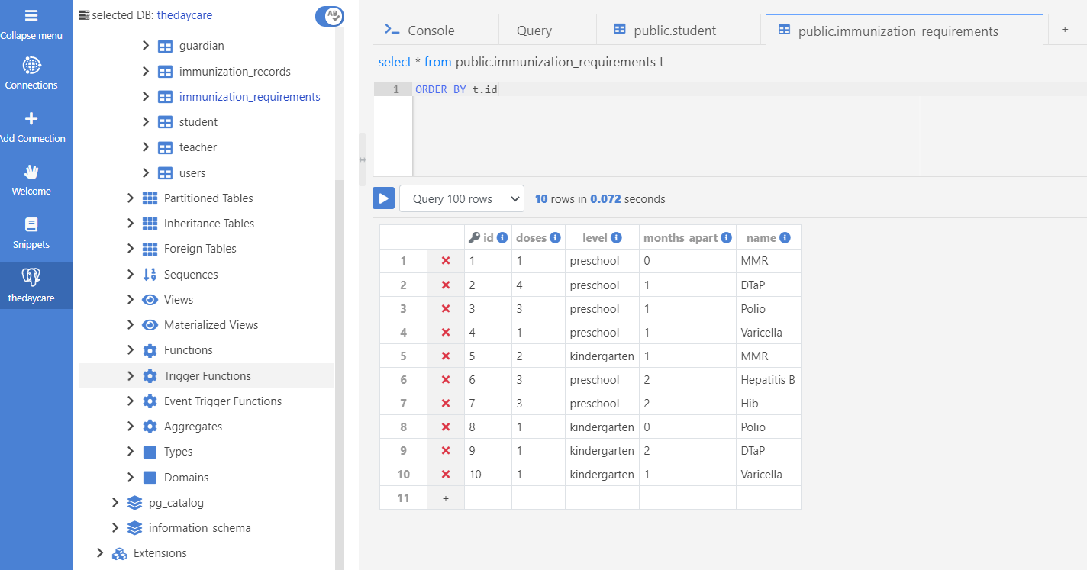
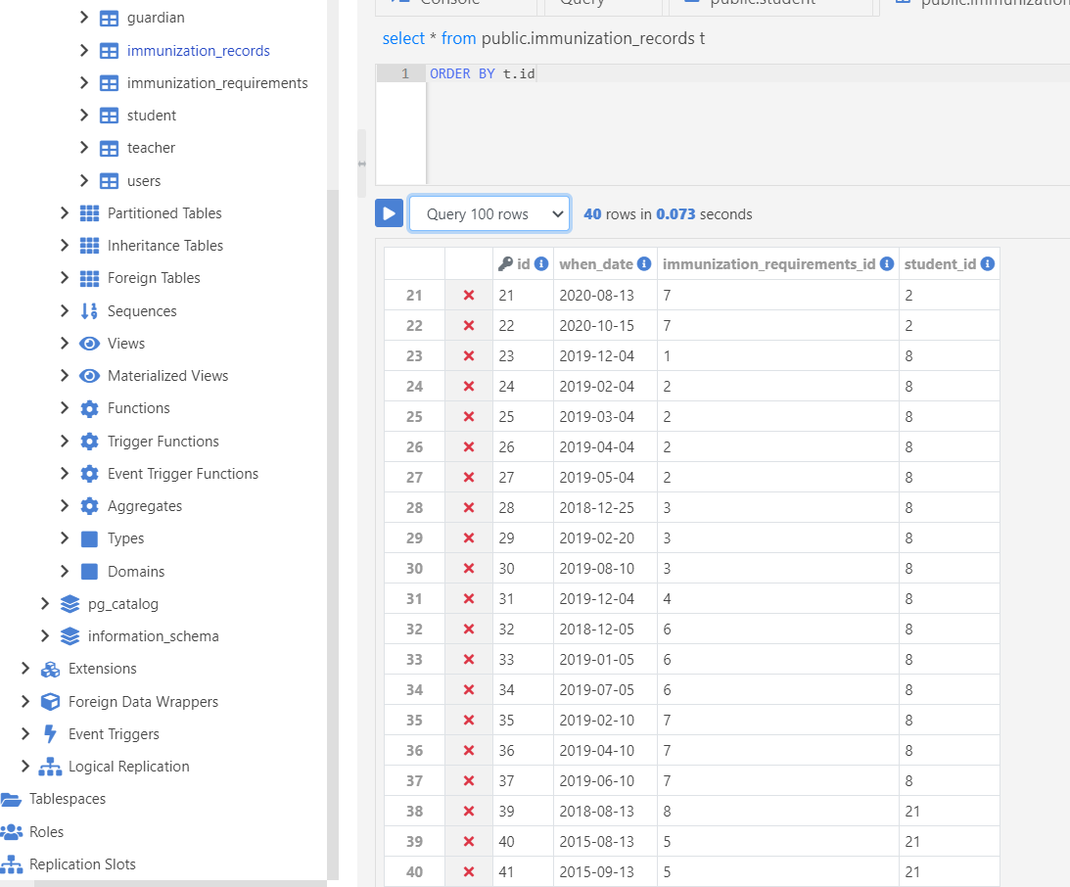

Slide 10



